Slide 1
Mathematics for Machine Learning
Session 1
7/26/2019
Dino de Raad

Slide 2
Roadmap

Slide 3
Roadmap
Goal for today’s session: Introduce core mathematical foundation for ML
Goal for introductory sessions: Interpretation of ML results, strengths and weaknesses of common models, intuitions on why ML models work and how they work from mathematical perspective
Goal for core sessions: Implement ML models from math foundation, focus on numeric optimization, model selection, and result quality

Slide 4
Mathematics for Machine Learning

Slide 5
Mathematics for Machine Learning
Linear Algebra
Calculus
Probability
Statistics

Slide 6
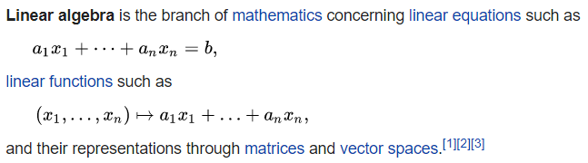
Linear Algebra
All data can be represented as a tensor, matrix or vector
All other math must be conceptualized in terms of linear algebra for computational efficiency
Matrix decomposition is fundamental for dimensionality-reduction techniques

Slide 7
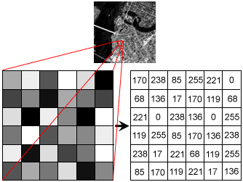
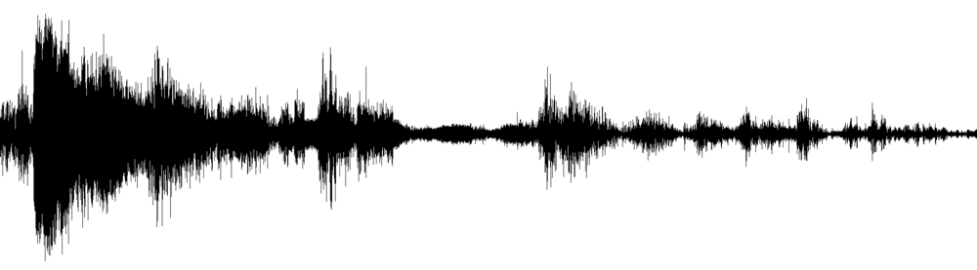

Linear Algebra

Slide 8
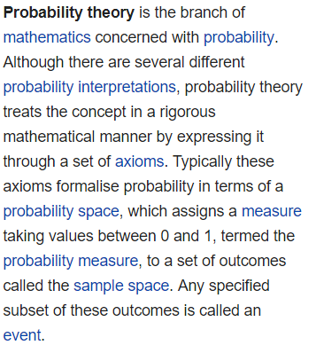

Probability and Statistics
Probability is fundamental to error measurements like log likelihood
Statistics is fundamental to interpretation of ML model results
[…]

Slide 9
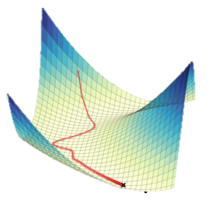
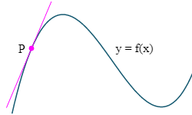
Calculus
[…]
Core of optimization mathematics
Derivatives required to perform gradient descent, backwards propagation, etc.

